Slide 1
Global PPQ Status Summary
December 6, 2025

Slide 2
Overview
Showing the overall “health” of Orlando and Berlin casting and post-casting PPQs by summarizing them by status.
Suppliers overall PPQ status
Overall goal of having qualified PPQs that are unconditionally released and minimizing expired PPQs.

Slide 3

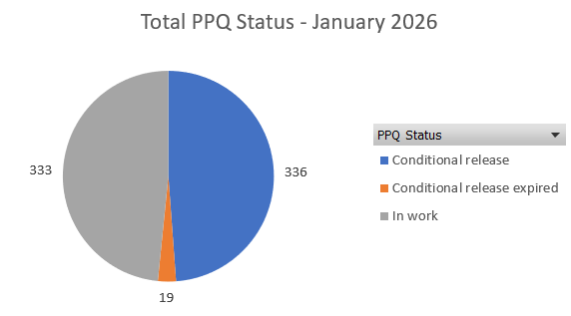
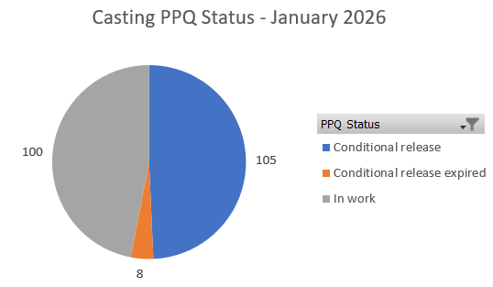
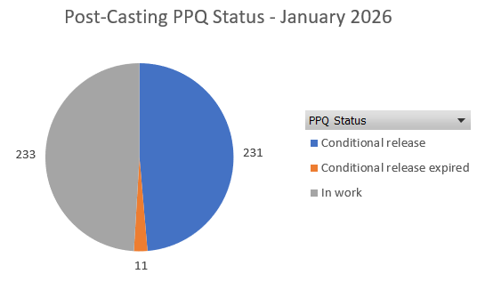
Total PPQ Status
Casting: Conditional + Expired: 210
Post-Casting: Conditional + Expired: 410
Conditional release expired are from plant 1200
Notes:
Add table?
Start unconditional at 0
Increase in Unconditional PPQs by … this month.
Changes in the last month:

Slide 4
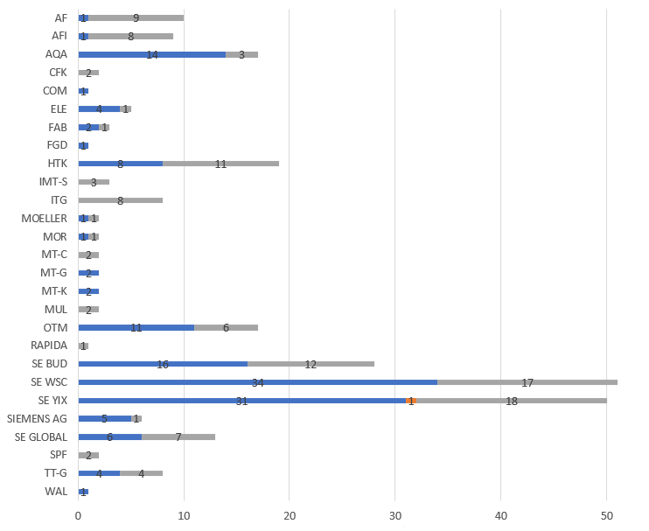
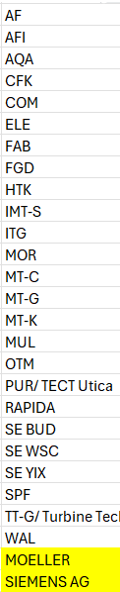
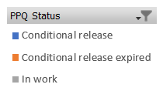
Post-Casting: Conventional Machining Open PPQ Status

Slide 5
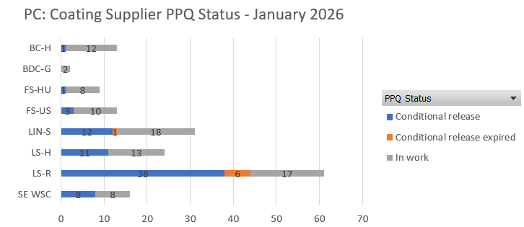
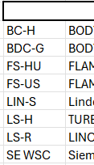
Post-Casting: Coating Open PPQ Status

Slide 6
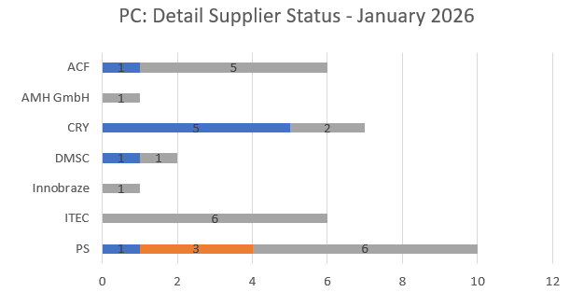
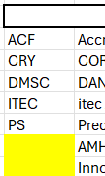
Post-Casting: Detail / Assembly Open PPQ Status

Slide 7
Actions / Goals
Actions:
Send monthly PPQ Status update with information tracking progress made.
Check for PPQs that could be unconditionally released or may be close to being unconditionally released.
Send list of PPQs about to expire before the end of the month.
Tracking some parts from our team leads that are STG5 (50 Hz) frames, from plant 1200.
Goals:
Go back to having the trend of a high quantity of PPQs being closed.
Have no PPQs with the status conditional approval expired.

